Slide 1

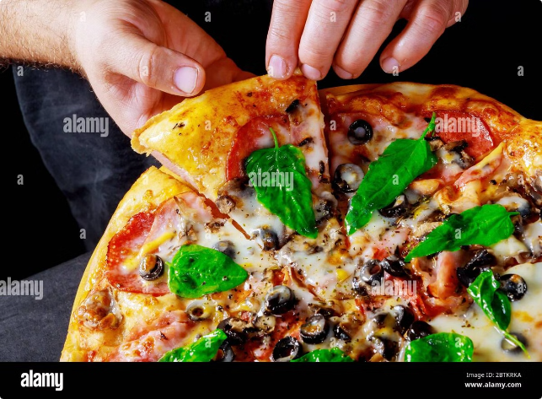

Pizza Sales Analysis and Recommendations
This presentation delves into a comprehensive analysis of pizza sales data, identifying key trends and providing actionable recommendations to enhance revenue and customer satisfaction. The insights gained from this analysis are crucial for optimizing pizza operations and maximizing business potential.
by shreeram kulkarni

Slide 2
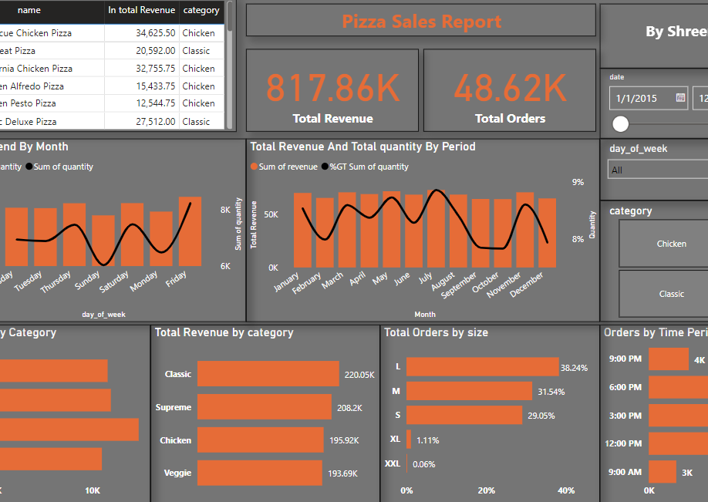
Steps:
Data cleaning
Creating database in MySQL and importing data into it
Performing SQL operations
Importing data to Power BI
Performing DAX queries for additional measures and columns
Completing full analysis of the data
Generating insights and recommendations

Slide 3

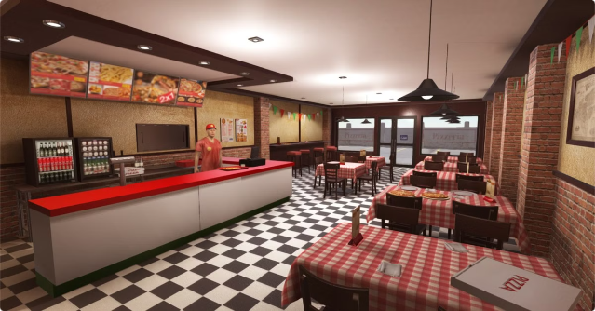
Sales Overview
In the fiscal year, our pizza establishment generated a total revenue of $817,860. This impressive figure is a testament to the consistent demand for our pizzas. Throughout the year, we served a total of 48,620 orders, highlighting the popularity of our offerings among customers.

Slide 4
Top Performing Pizzas
The sales data reveals a clear preference for certain pizza varieties. The top five best-selling pizzas, accounting for a significant portion of our revenue, are: BBQ Chicken, Big Meat, California Chicken, Chicken Alfredo, and Chicken Pesto. These pizzas consistently attract customers, indicating a strong appeal for chicken-based flavors and hearty toppings.
BBQ Chicken
Big Meat
California Chicken
This classic combination of smoky BBQ sauce, tender chicken, and tangy red onions continues to be a customer favorite.
Meat lovers rejoice! This pizza is loaded with pepperoni, sausage, bacon, and ham, making it a satisfying choice for carnivores.
The California Chicken pizza features a refreshing blend of grilled chicken, artichoke hearts, and creamy pesto sauce, offering a balanced flavor profile.

Slide 5
Sales by Day of Week
Analyzing sales trends across the week reveals distinct patterns in customer behavior. We observed consistently high sales on Fridays, Saturdays, and Thursdays, demonstrating a strong weekend demand and a notable preference for Thursday evenings. However, sales experience a significant drop on other days, particularly Sundays and Tuesdays. This pattern indicates a potential opportunity to enhance sales during these quieter periods.
1
Friday
Sales peak on Fridays, likely due to the start of the weekend and social gatherings.
2
Saturday
Saturday also sees high sales, as people enjoy their weekend leisure with pizza.
3
Thursday
Thursday is another busy day, potentially due to people celebrating the end of the workweek.

Slide 6

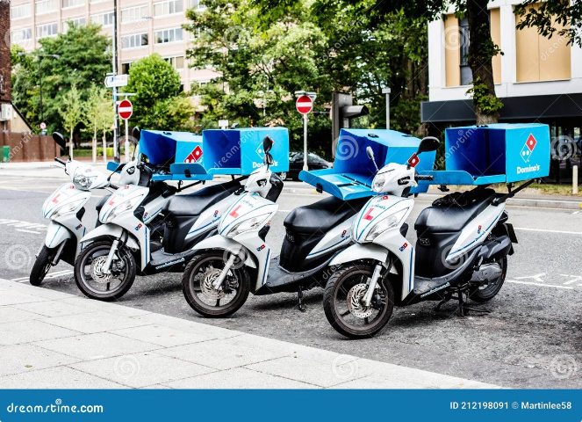
Monthly Sales Trends
Examining sales data over the months reveals a noteworthy trend. While sales generally remain consistent throughout the year, we noticed a significant drop in sales during September and October. This downturn could be attributed to various factors such as seasonal changes, competition, or consumer behavior. It's essential to investigate these factors and implement strategies to mitigate this sales decline.
1
September
Sales drop noticeably in September, indicating a potential need for marketing strategies to combat the decline.
2
October
Sales remain lower in October, highlighting the importance of addressing the seasonal slump in revenue.
3
Summer Months
Sales are generally higher during summer months, reflecting increased outdoor gatherings and celebrations.
4
Holiday Season
Sales often peak during holiday seasons, such as Thanksgiving and Christmas, due to increased celebrations and family gatherings.

Slide 7
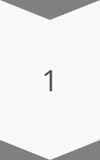

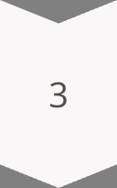
Peak Order Times
The analysis of order volume by time of day reveals a distinct peak period between 12 PM and 3 PM, indicating a significant influx of orders during the lunch and early afternoon hours. This concentration of orders presents both an opportunity and a challenge. It's crucial to optimize operations to efficiently manage this high volume and ensure timely delivery and customer satisfaction.
12 PM - 1 PM
Sales start to increase, indicating the beginning of the lunch rush.
1 PM - 2 PM
Sales continue to rise, with a significant number of orders placed during this hour.
2 PM - 3 PM
The peak order volume occurs during this period, highlighting the need for efficient operations.

Slide 8

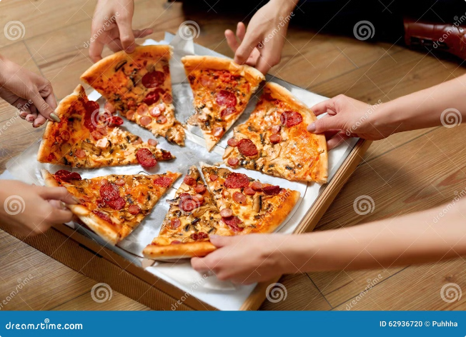
Sales by Pizza Size
Examining sales distribution by pizza size reveals a clear preference for smaller sizes. L, M, and S sizes consistently generate higher sales compared to XL and XXL sizes. This suggests that customers may be choosing smaller sizes for affordability or portion control. It's important to consider strategies to boost sales of larger sizes, such as creating targeted promotions or highlighting the value of sharing a larger pizza.
Size
Sales Percentage
L
38.24%
M
31.54%
S
29.05%
XL
1.11%
XXL
0.06%

Slide 9

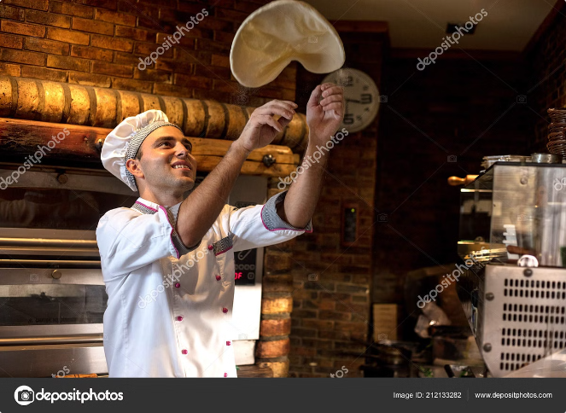
Recommendations
Based on the insights gained from the data analysis, we recommend implementing a series of strategic initiatives to optimize operations, enhance sales, and increase customer satisfaction. These recommendations are designed to capitalize on existing strengths, address areas for improvement, and ultimately drive sustained growth for our pizza business.
Targeted Marketing
Focus marketing efforts on Friday, Saturday, and Thursday by promoting special offers, highlighting the appeal of these high-selling days, and using targeted advertising.
Peak Hour Optimization
Optimize operations for peak hours (12 PM - 3 PM) by ensuring adequate staffing, efficient order processing, and timely delivery to enhance customer satisfaction.
Customer Feedback
Implement a system to gather customer feedback on less popular pizza sizes and flavors, identifying areas for improvement and tailoring offerings to customer preferences.

Slide 10
Optimizing the Menu and Expanding Reach
Menu Optimization: Expand chicken-based pizza options to cater to the growing popularity of chicken-topped pizzas.
Delivery Partnerships: Explore collaborations with food delivery platforms to expand reach, especially during non-peak hours and days.
Customer Feedback: Gather input on less popular pizza sizes and flavors to identify areas for improvement and tailor the menu to customer preferences.

